Slide 1



ALT-index: A Hybrid Learned Index for Concurrent
Memory Database Systems
Yuxin Yang†, Fang Wang†, Mengya Lei☨, Peng Zhang†, Dan Feng†
†Huazhong University of Science and Technology
☨Hubei University of Technology
41st IEEE International Conference on Data Engineering, Hong Kong SAR, China, May 19-23, 2025
Notes:
Hello everyone! I am yuxin yang from huazhong university of science and technology. Today I am going to talk about our work about a hybrid learned index structure for database systems.

Slide 2
Outline
Background
Motivation
Design
Evaluation
Notes:
There will be four sections in my today’s lecture. First, I will briefly introduce the background. Second, I will explain our motivation and the challenges we need to overcome through our design. Third, I will talk about the design and how we address these issues. Last, I will give the evaluation of our work in details.

Slide 3





Database System
Disk-Based Database
Low performance with large capacity
Disk friendly index structure (e.g. B+tree)
Memory-Based Database
High performance with limited space
Efficient in-memory index structure (e.g. Adaptive Radix Tree)
Notes:
Database system is one of the most common storage systems in recent years. Disk-based databases such as MySQL can store data persistently with a large capacity. However, memory databases such as Redis are better choices when it comes to high-performance and low-latency scenarios. Moreover, it is worth noting that index structures are important components in both disk and memory databases, which can accelerate the query processing.

Slide 4
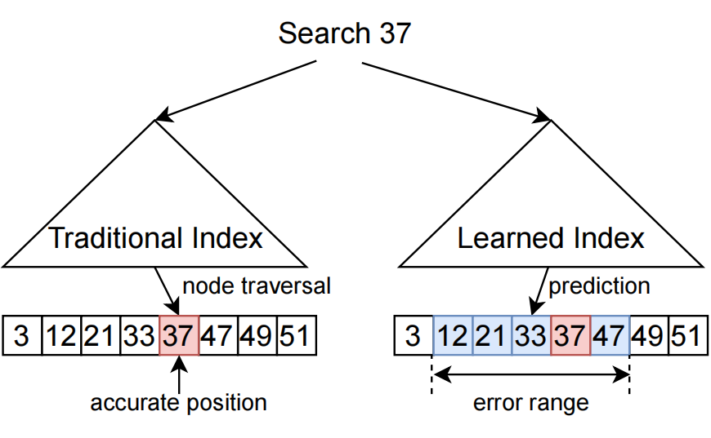



In-Memory Index Structure
Traditional Index (Node based)
Slow lookup performance
High space overhead
Efficient SMOs for insert
Learned Index (Model based)
Fast lookup performance
Low space consumption
Costly retraining for insert
Traditional Learned
Notes:
In this work, we will concentrate on the in-memory index structures. There are two types of them so far, the one is the node based traditional index and the other is model based learned index. Compared to traditional index, the learned index has better lookup performance and lower memory consumption. However, the insert performance of the learned index is limited due to the costly retraining process.

Slide 5




C1: Can we burn the candle at both ends?
Adaptive Radix Tree
Slow lookup
High memory consumption
Good insert performance
Learned Index
Fast lookup
Low memory consumption
Bad insert performance
 | Lookup-only (MOPS/s) | Insert-only (MOPS/s)
★ALEX+ | 136.65 | 26.33
★LIPP+ | 173.54 | 4.02
★FINEdex | 62.91 | 18.08
★XIndex | 70.75 | 14.60
*ART-OLC | 90.80 | 34.32
+
=
A: Hybrid Learned Index !
★learned indexes *traditional indexes
Notes:
Based on the facts we mentioned above, we simply list the advantages of the typical in-memory index structure and the learned index. We test their performance using 32 threads. In our experiments, we use Adaptive Radix Tree, which is the most widly used traditional index in memory database. Besides, we choose four state-of-the-art learned indexes in comparsion. As we can see in this form, the learned index performs better under the read-only workload, while ART shows good performance under insert-only workload. The results inspire us that maybe we can use a hybrid design to take full advantage of the learned index and ART.

Slide 6
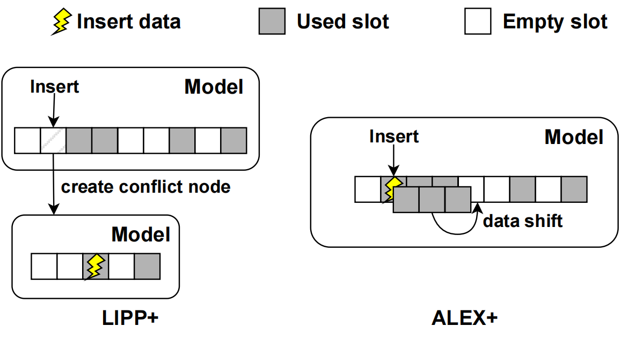
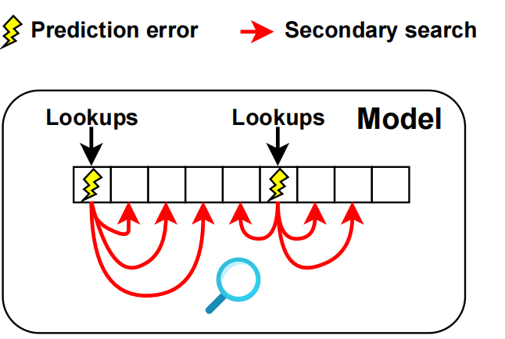
C2: Limitation of Learned Index
Prediction Errors in Existing Learned Index
Write bottleneck
Secondary search bottleneck
Write amplification
Secondary search
Create conflict node: 40.7% Data shift: 25.2%
FINEdex & XIndex perform poor in lookups.
ALEX+ saturate the memory at 16~32 threads!
Notes:
So our hybrid index idea requires a high performance learned index structure. In the existing learned index designs, they introduce prediction errors after the model training. And that will bring some secondary schemes to correct the prediction errors. Here, we conclude those schemes and finally summarize two bottlenecks of prediction errors. First, those schemes will cause write amplification and block other threads in concurrent conditions. For instance, LIPP+ will copy data to the newly created conflict node, and ALEX+ will shift the adjunct data to reserve an empty slot for the new data. Second, the prediction errors will bring secondary search within a predefined error bound. That will restrict the lookup performance and quickly saturate the memory bandwidth, especially in concurrent read-write scenarios.

Slide 7

C3: Limitation of ART
Complex Issues in ART
Long traversal length
Block problem
common nodes
lock coupling
subtree nodes
blocked nodes
Long length traversal
Blocked sibling nodes
All subtree nodes traverse common nodes!
Insert with lock coupling scheme blocks nodes!
Notes:
Also, our hybrid index idea requires high-performance ART. In the existing ART structure, we also find two potential bottlenecks. First, we find that visiting the leaf nodes within a subtree needs to traverse some common nodes from ART root node, as shown red nodes in the left picture. Second, in concurrent scenarios, when we are modifying an ART node(you can find the yellow nodes in the right picture), the current lock coupling scheme will lock the parent and the child node until the modification is done. However, the locked parent node may block the operations on the rest of its child nodes and their subtrees, which you can find the red nodes in the right picture.

Slide 8
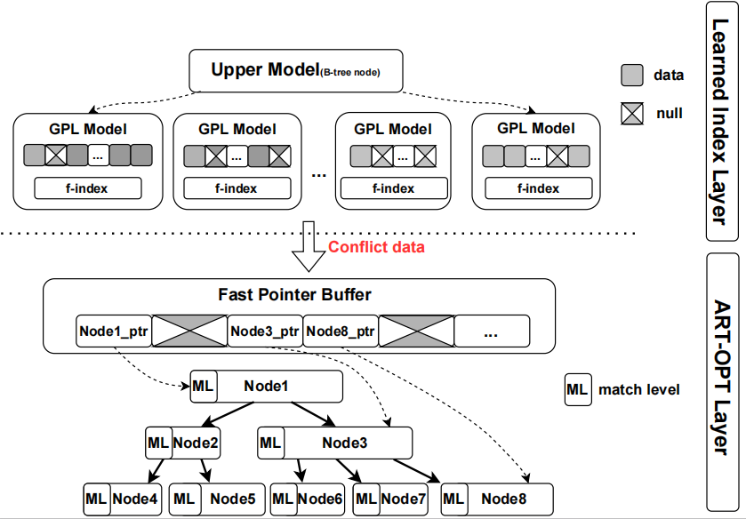
Our Solution: ALT-index
②
ALT-index Overview
Hybrid Construction
Two layer design
Conflict dataflow
Learned Index Layer
GPL algorithm
Dynamic retraining
Optimized ART Layer
Fast pointer buffer
①
③
Notes:
Finally, we come up with our hybrid learned index design, called ALT-index. In our design, we develop a two layer construction with a conflict dataflow. Then, we optimized the learned index layer and ART layer based on our analysis above to improve the overall performance.

Slide 9
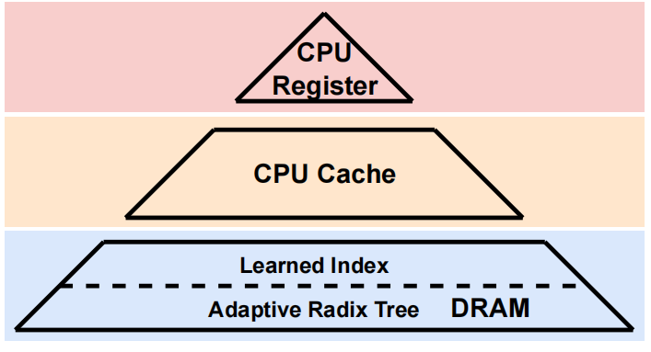
O1: Hybrid Construction
Two-layer Design
Learned Index Layer
Lookup operations
In-place insert operations
Adaptive Radix Tree Layer
Lookup operations after insert
Out-of-place insert operations
Latency
 | Lookup | In-place insert | Out-of-place insert
Learned Index | Fast √ | Fast √ | Slow ×
ART | Slow × | None × | Fast √
Latency
Notes:
First of all, we introduce a two-layer hybrid index construction. Learned index performs better on low-latency operations such as lookup and in-place insert, so we put it on the top layer. ART performs better on out-of-place insert compared to learned index model retraining. So we put ART in the lower layer to handle the inserts that cannot be inserted in-place into the learned index layer. The first challenge is solved through our hybrid construction design.

Slide 10
O1: Hybrid Construction
Conflict Dataflow
Learned Index Layer
Adaptive Radix Tree Layer
Learned Index Model
Conflict Insert
Linear Function
In-place Insert
Conflict Insert
Decouple operations to the corresponding layer
Notes:
Based on our two-layer design, we propose a conflict dataflow to decouple different types of operations. First, we insert the data in-place in the learned index layer if it is predicted to an empty slot. If the data is predicted to an occupied slot, we simply put it into the lower ART layer. Notably, we call the data in the learned index layer “linear data”, and we call the data in the ART layer “non-linear data”. There is no prediction error in ALT-index; the second challenge is well solved.

Slide 11
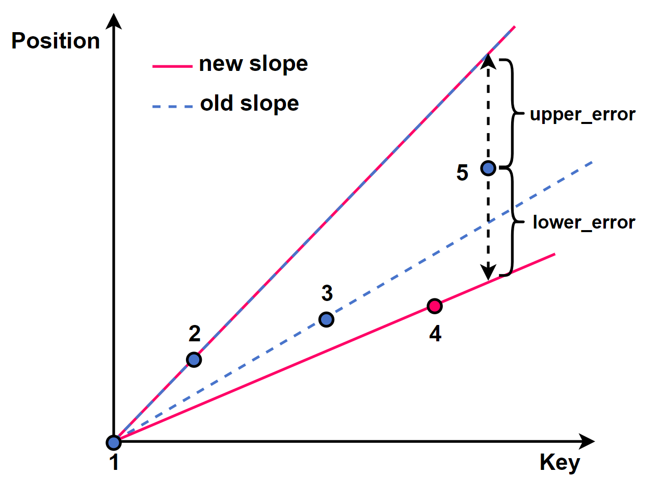
O2 : Learned Index Layer
Segment Algorithm
Old algorithm
GPL algorithm
Point 5 lower error become bigger
Position
ideal
real
Position
ideal
real
Point 4 updates slope
Key
Key
Consider max error
Consider every error
Over 50% data have prediction conflicts on avg.
Only 30% data have prediction conflicts on avg.
Notes:
Further, we optimized the learned index layer through a segment algorithm. Existing algorithms only consider the max error of a model and minimize the number of segments. However, in our two layer design, that will introduce too many prediction conflicts and put more data into the ART layer. So we introduce a GPL algorithm to consider every error within a segment to cut down prediction conflicts. Here we briefly introduce our algorithm. We use two linear function to calculate the error of a new data point. If the error overflows the predefined error, we will make a segmentation. These two linear function will be updated once an non-linear data is added. These updates caused by non-linear data will scale out when we calculate the following data’s error, and finally influence the segmentation. As shown in the right picture, point 4 cause the updates of the lower slope, and that will increase the lower error when we add the point 5. Through our GPL algorithm, ALT-index will consider every non-linear data and leave more data in the learned index layer to improve lookup performance.

Slide 12
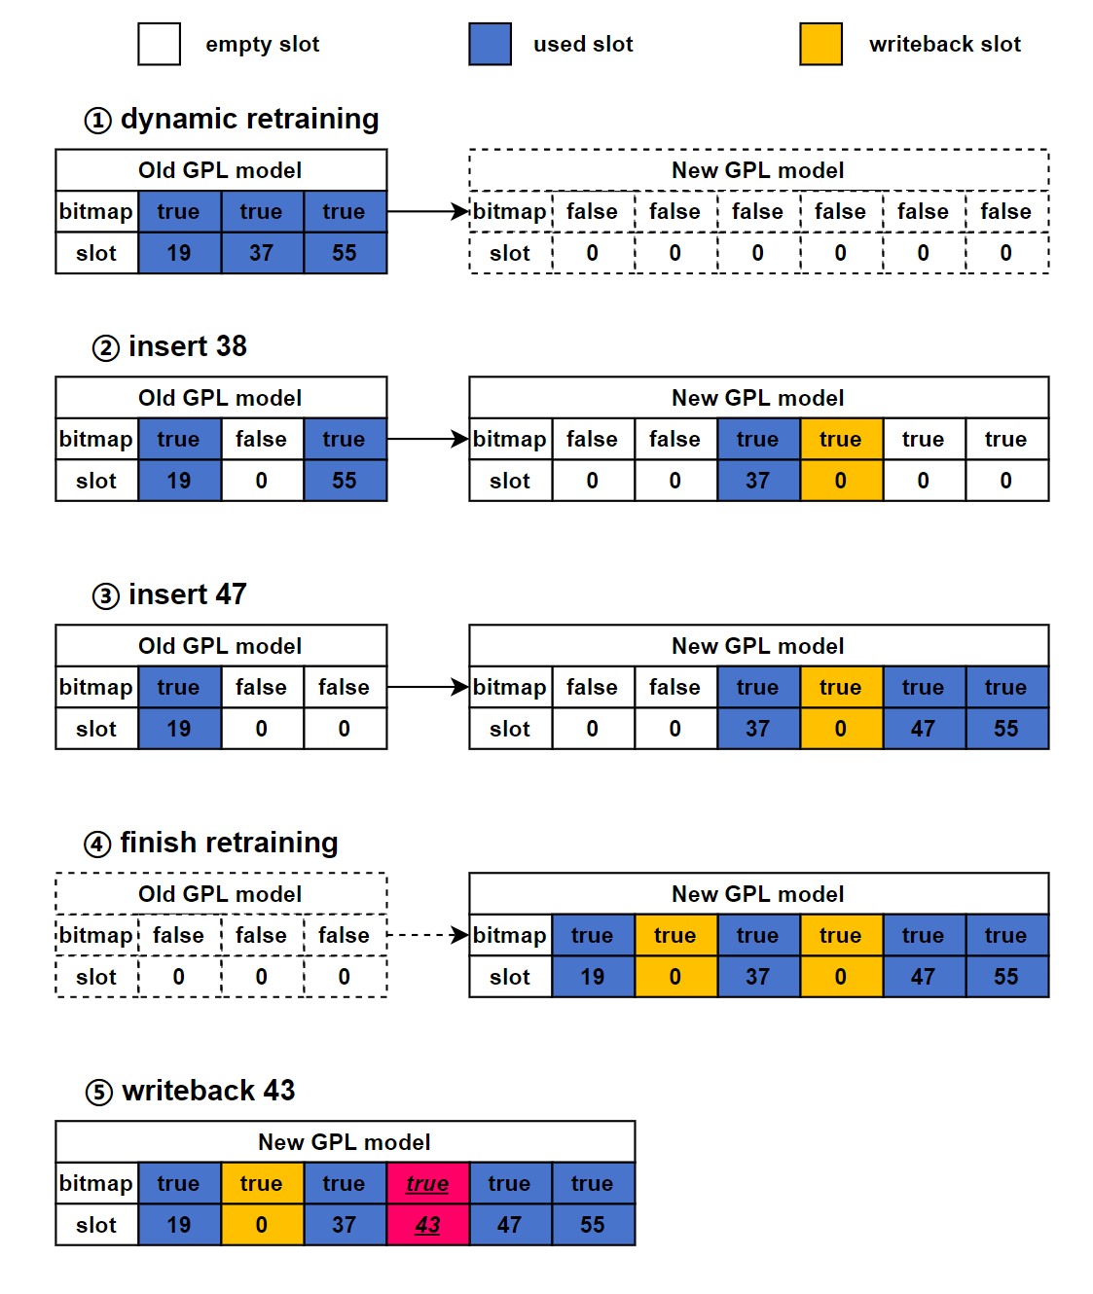
O2 : Learned Index Layer
Dynamic Retaining
Evict old model
Evict 37, Insert 38 to ART
Writeback 43 to potential slot
Evict 55, Insert 47
Writeback data from ART Layer
Notes:
Moreover, when it comes to dynamic workloads, we design a dynamic retraining scheme to writeback data from ART. Inserted data to a model will cause a dynamic retraining process. First, a new model which is twice larger than the old one will be created behind. Second, any inserts will evict the data with the same predicted position from the old to the new model. Thrid, if the inserted data cannot be put into the new model in-place, it will be inserted to ART. Finally, we evict all the data in the old model when the new model space is used over 50%. We also introduce a scheme to writeback data from ART layer. If we looup a data in the ART layer and its predicted position in the learned index layer is empty, we can writeback these data immediately and delete it from ART.

Slide 13
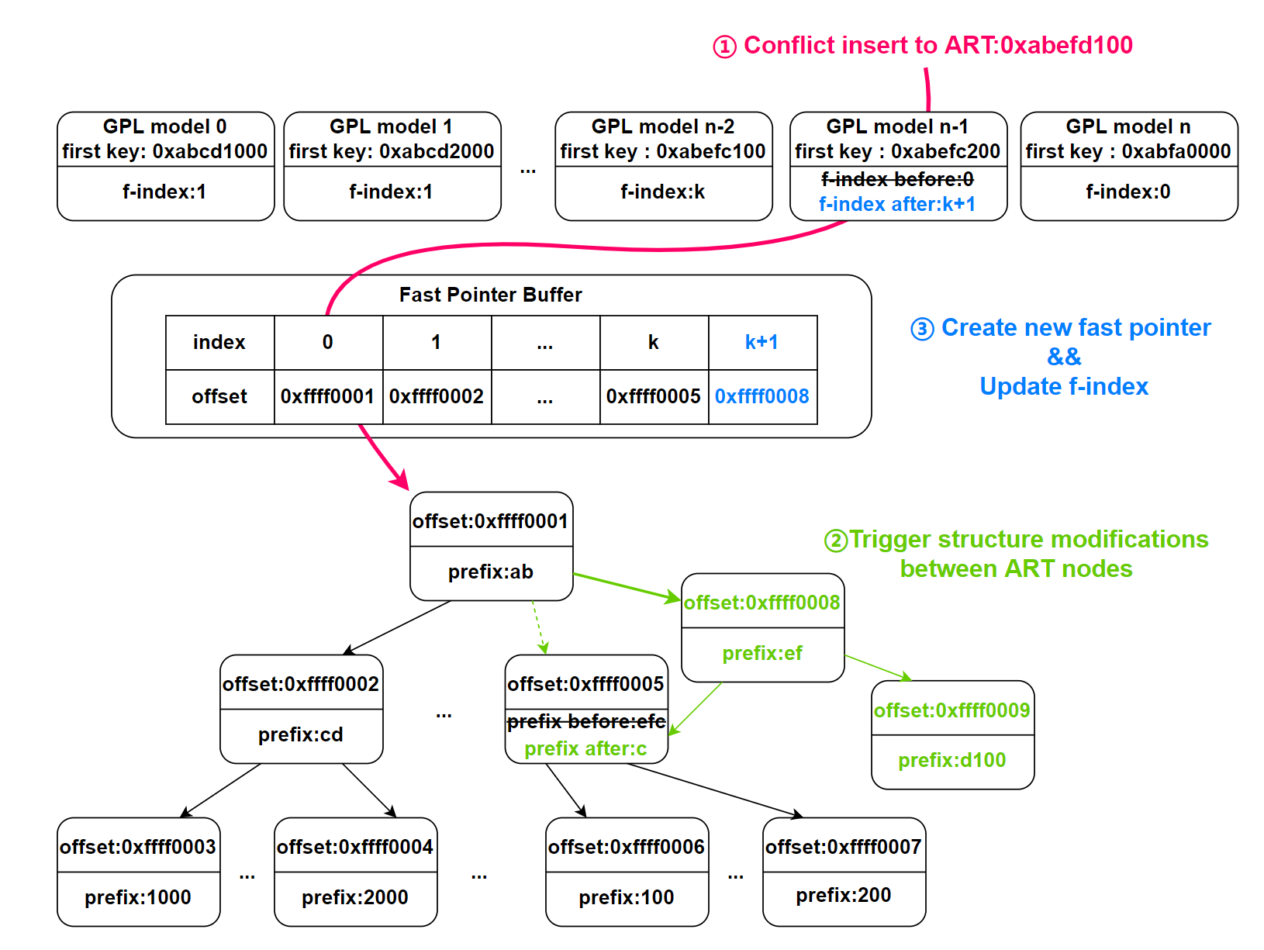
O3 : Optimized ART Layer
Fast Pointer Buffer Scheme
Build fast pointers
Cut down traversal length
Merge duplicated fast pointers
Space efficient
Data consistency for ART SMOs
Efficient ART traversal
Notes:
Finally, we introduce an optimized ART layer. We propose a fast pointer buffer design, which links each model with ART subtree. This can largely cut down the average lookup length in ART. Moreover, we merge the common fast pointers in this buffer to keep data consistency when ART meets structure modifications in concurrent scenarios. For instance, as shown in the right picture, when ART has SMOs due to an insert, we simply finish that modification and update the fast pointer in the buffer without updating every f-index in each model. The models with the same f-index don’t need to be updated then. To sum up, the fast pointers can cut down the traversal length in ART and improve the block issue of sibling nodes in concurrent scenarios. Challenge 3 is perfectly solved.

Slide 14



Evaluation
Environment
Hardware
Intel Xeon Gold 6240@2.60GHz × 2
186GB DDR4 Memory
Software
GCC 9.4.0, CMAKE 3.16 with O3 optimization
4 real-world datasets
Competitors
ART [DaMoN ‘16]
ALEX+ [VLDB’22]
LIPP+ [VLDB’22]
FINEdex [VLDB’21]
XIndex [PPoPP’21]
Notes:
Our evaluation is produced on a Linux server with 2 Intel CPUs and 186GB memory. We choose four real world datasets with 200 million keys and select five competitiors, including a typical ART and four learned indexes.

Slide 15
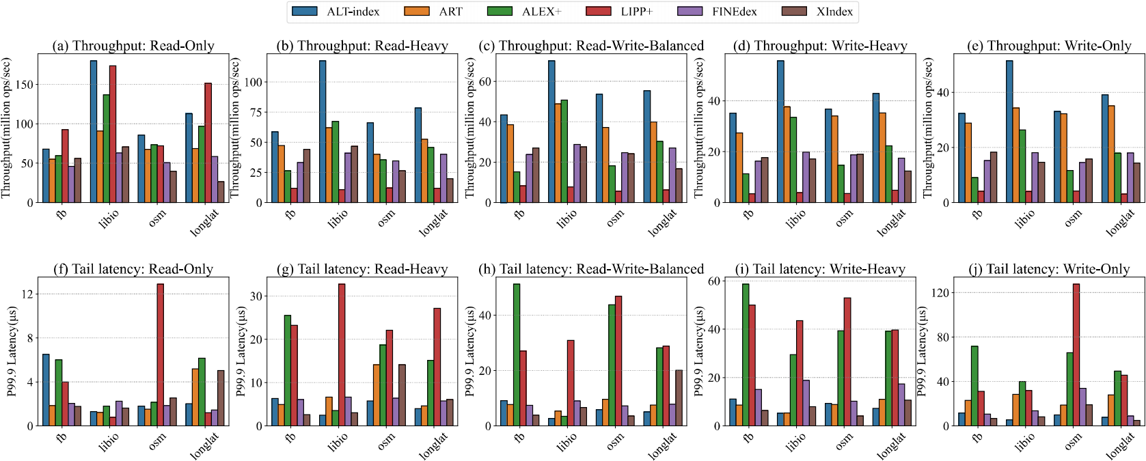
Throughput & Tail Latency
Fast pointer
Low tail latency
ALT-index improves the throughput by 1.9-2.3x on average.
Notes:
We first test the throughput and the tail latency of each index with 32 threads. Although in some linear datasets, LIPP+ performs better due to the conflict nodes and precise prediction, it shows bad performance when inserts occur. ALT-index shows the best performance under read-write workload. Even in the write-only workload, ALT-index still performs better than ART due to its hybrid construction and the fast pointers. The tail latency of ALT-index is lower because the fast pointers cut down the average length in ART.

Slide 16
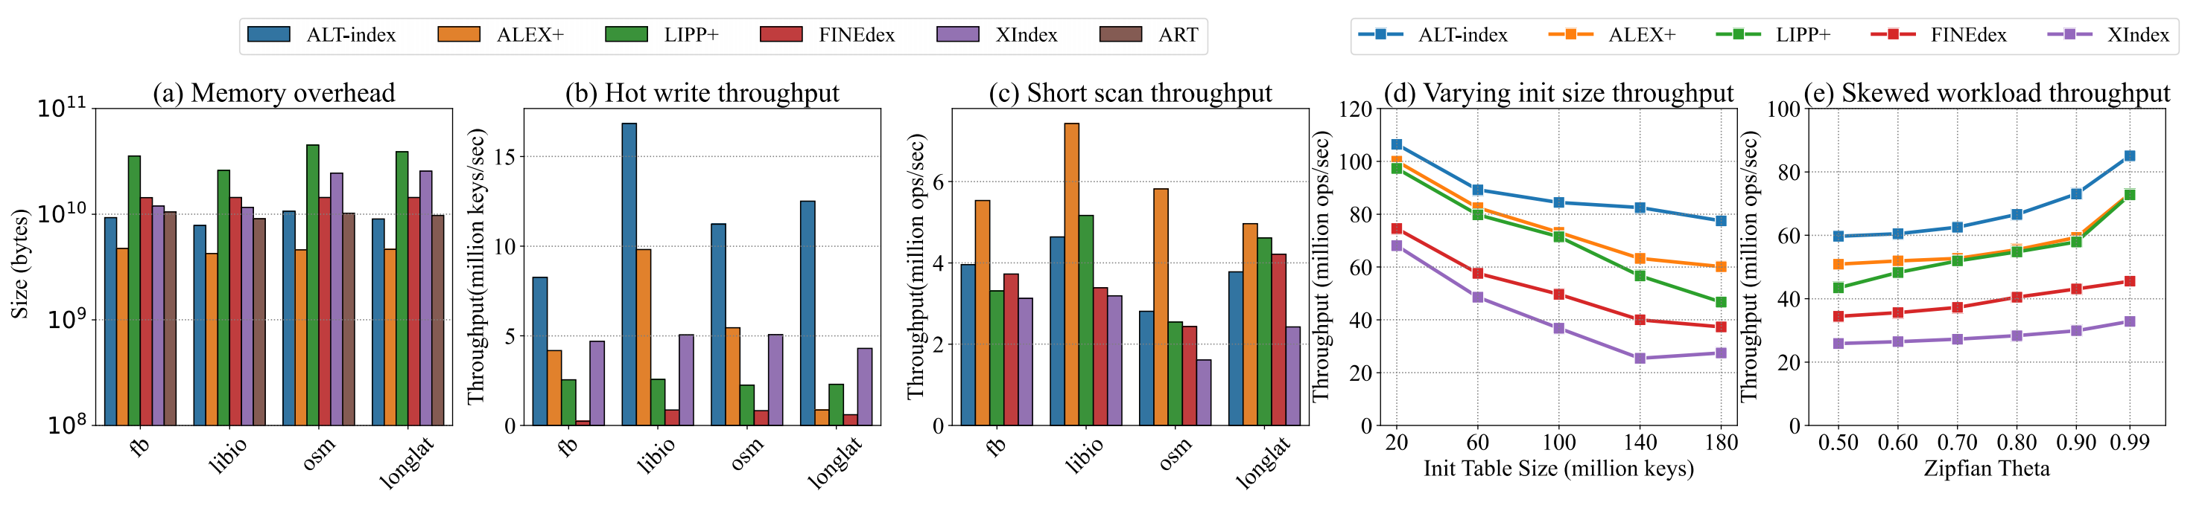





Robustness
Memory Overhead
Hot Write
Short Scan
Init Size
Skewness
ALT-index performs Good Robustness under different scenarios.
Notes:
In addition, we test the space efficiency, hot write workload, short scan workload, different init size, and different theta of zipfian to show the robustness of our design. ALT-index performs great out of other indexes, which shows great robustness under different scenarios.

Slide 17
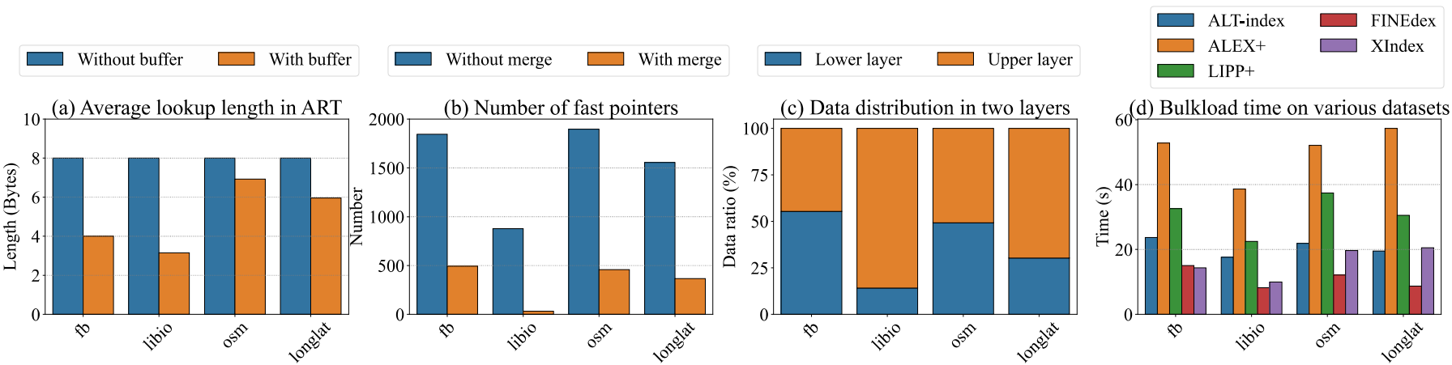


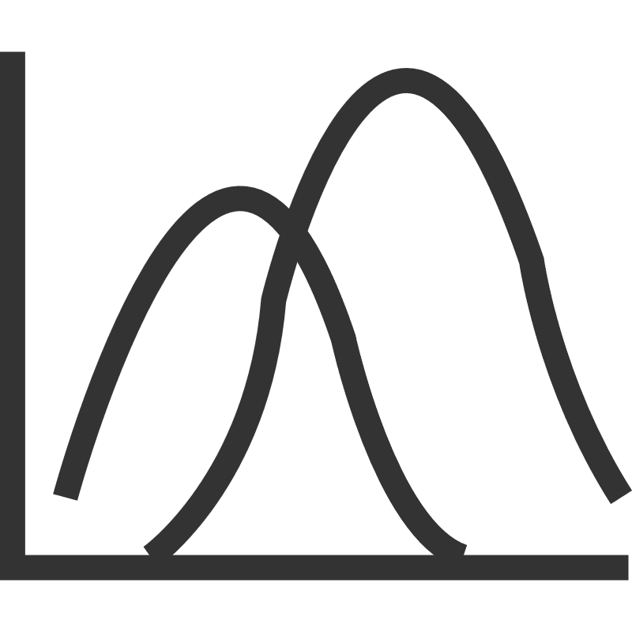

Other Analysis
Lookup Length
Merge Scheme
Data Distribution
Bulkload Time
ALT-index minimizes the expense of hybrid design.
Notes:
Last, we add some tests about the fast pointers and analyze the factors of our two-layer design. Fast pointer scheme largely cuts down the lookup length in ART layer, and its space is minimized through our merge scheme. We check the data distribution in two layers and find that over 50% of the data is reserved in the learned index layer. The bulkload time of ALT-index is not the best. That is attributed to the conflict data is put into the ART layer case-by-case.

Slide 18



Conclusion
Traditional Index Learned Index
ART has good write performance
Learned Index has good read performance
ALT-index Design: A Hybrid Learned Index
Two-layer construction
Optimized learned index layer
Optimized ART layer
ALT-index can take full advantage of both Learned Index and ART
Paper
Notes:
In this work, we first find the advantages and drawbacks of ART and learned index. Then, we come up with ALT-index which can combine learned index with ART. Further, we introduce several optimizations for our hybrid design. Finally, our experiments show that ALT-index can take full advantages from both learned index and ART. For more details, you can refer to our paper online.

Slide 19
Q & A
41st IEEE International Conference on Data Engineering, Hong Kong SAR, China, May 19-23, 2025
Notes:
Thank you!

